Slide 1
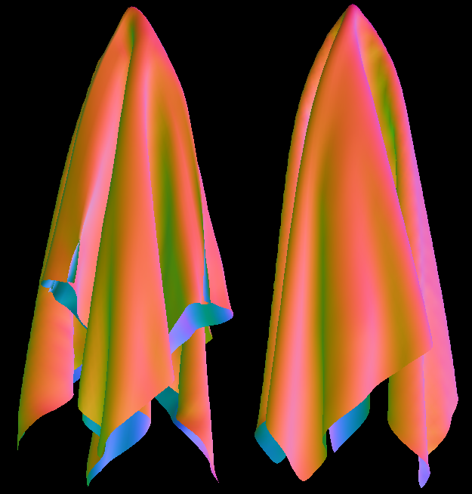
Stable Cloth Animation
By Matthew Fisher

Slide 2
Overview
Choose Underlying Model
Define Equations of State
Integrate Equations of State
  Deal With Explosions
Deal With Collisions
Rendering Techniques

Slide 3
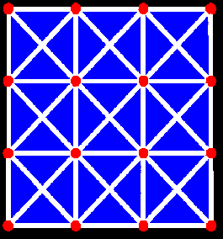
Choice of Model: Mass-Spring
Easy to understand and implement
Not as physically accurate as other models

Slide 4
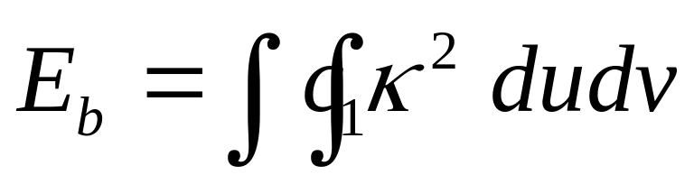


Choice of Model
Minimize Strain Energy
Elasticity-based forces

Slide 5
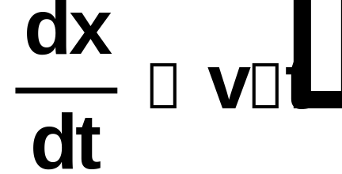
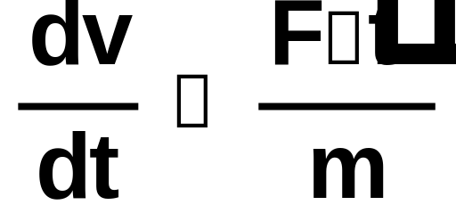
Equations of State
Define overall motion of the system
Given a state vector at a given time representing all relevant physical quantities (position, velocity) return the change in these variables w. r. t. time
In our case we have simple Newtonian equations:

Slide 6

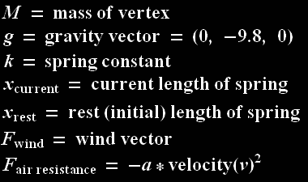
Equations of State: Force
F_{net}(v) = Mg + F_{wind} + F_{air resistance} –

Slide 7
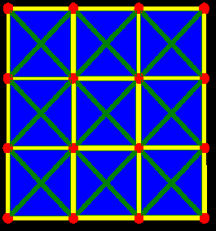
Equations of State: Force
Damping Springs: Springs resist relative, not absolute, changes in velocity
F_{damp} = k_{damp}(velocity(v1) – velocity(v2))
Diagonal springs resist changes in shear
Horizontal / Vertical springs resist compression

Slide 8
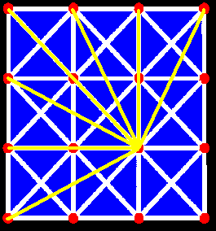
Equations of State: Force
Bending forces: cloth resists high curvature
We can simulate this well with bending springs

Slide 9
No bending springs
Bending springs

Slide 10
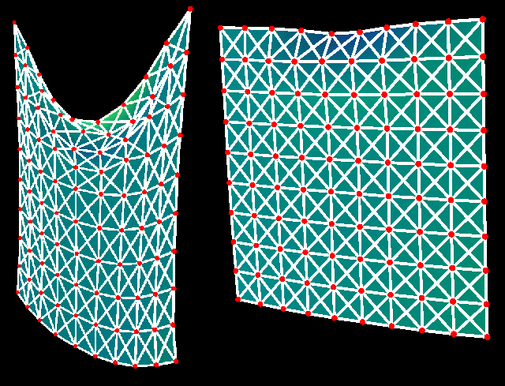
Variation of Parameters
Low k - sagging
High k - stiff

Slide 11
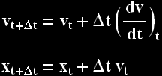

Integrating Equations of State
Explicit vs. Implicit vs. Symplectic
Euler’s Method (1st order)
Runge Kutta (4th order)
Verlet Algorithm

Slide 12
Integrating Equations of State
Implicit integrators are stable but slow and tedious to implement
Symplectic integrators are fast but hard to generalize
Explicit integrators are easy to implement but unstable

Slide 13
Integrating Equations of State
We can make an explicit integrator stable with an energy-corrective step, which restricts the total energy of the system
This step limits the maximum energy a spring can contain. If a spring exceeds this limit, we compress / expand it until it is at the limit, and repeat until all springs are corrected

Slide 14
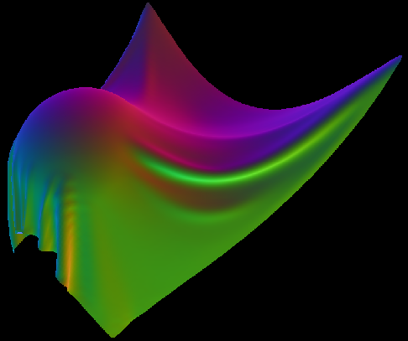
Cloth-Object Collisions

Slide 15
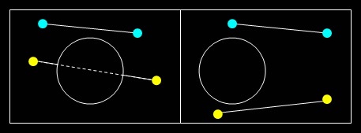
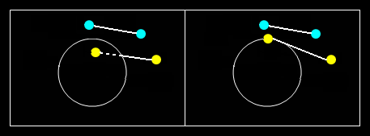
Cloth-Object Collisions
Ignore edges, and fix all offending vertices.
Cases we ignore:
The case we fix:

Slide 16
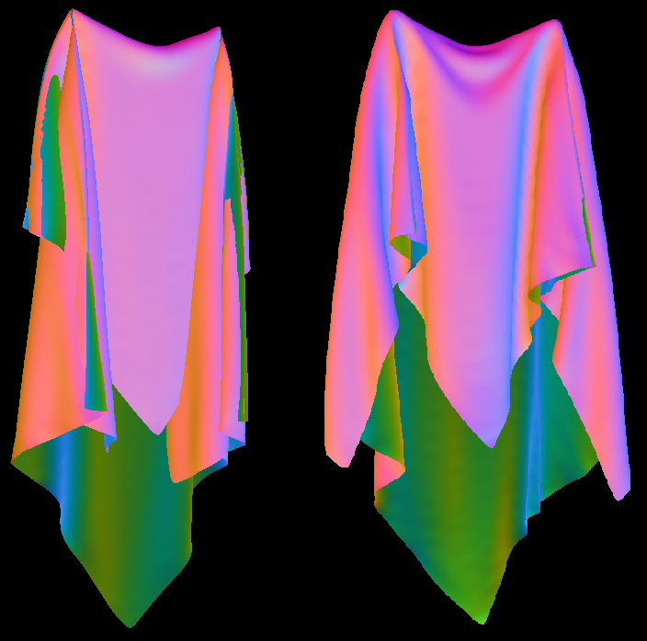
Cloth-Cloth Collisions

Slide 17
Cloth-Cloth Collisions
We imagine a virtual marble to be centered around each vertex
Marbles are not considered to be touching if their associated vertices are connected by a spring
If no two marbles pass through each other between t and t + dt, the cloth has not intersected itself
If the new positions contain vertices whose marbles are inside each other, back the vertices up such that this collision has not occurred (although we remain at the new time step.)

Slide 18
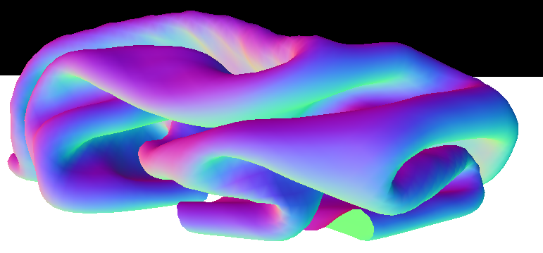
Cloth-Cloth Collisions

Slide 19
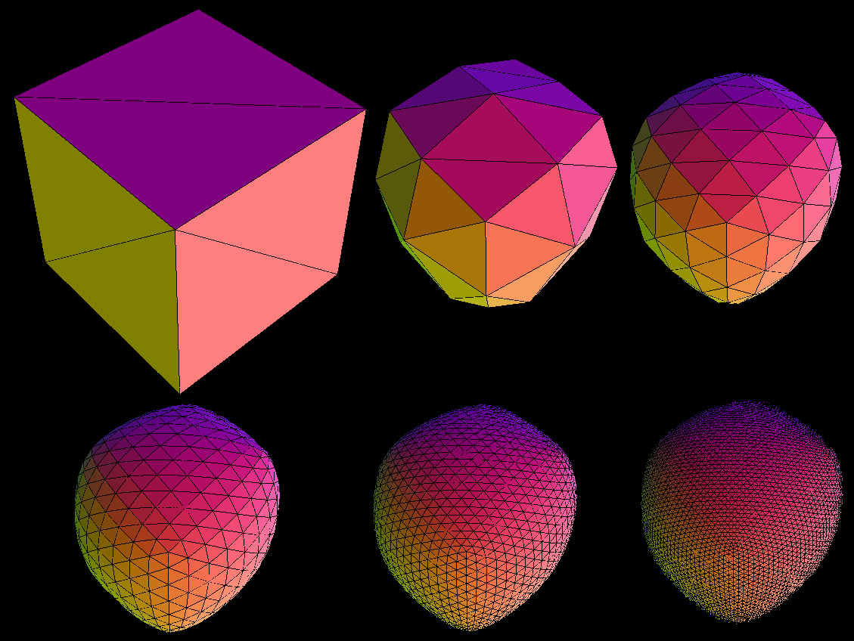
Rendering Techniques: Subdivision

Slide 20
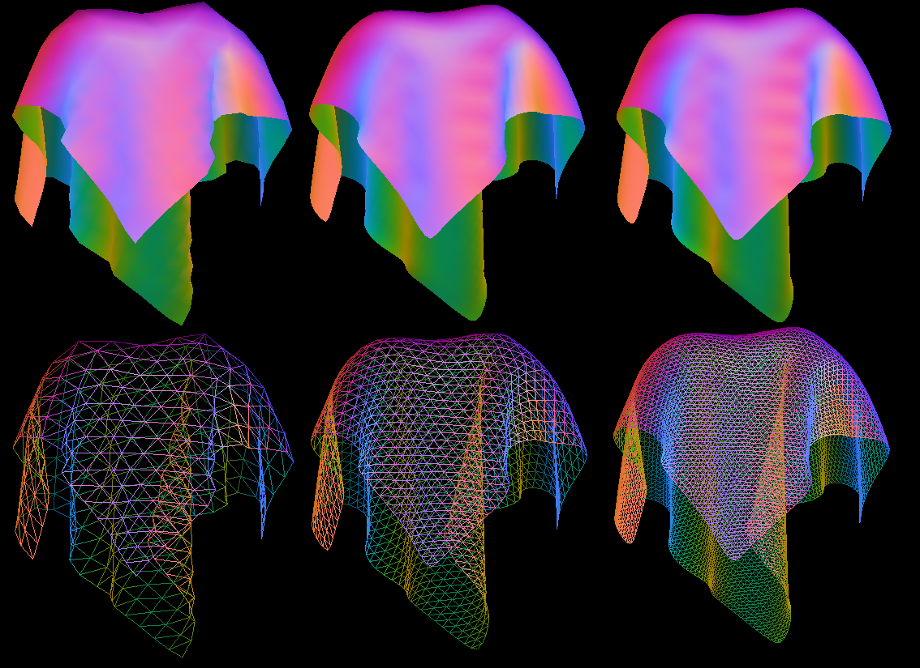
Rendering Techniques: Subdivision

Slide 21
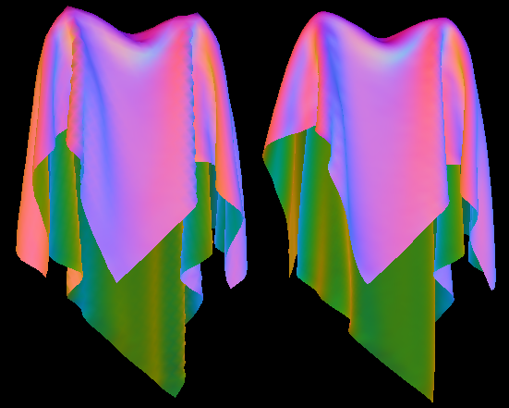
Loop Subdivision

Slide 22

Quilting
Many types of thin shells have a very visible thickness, such as a quilt or cotton sweater.
Rather than simulating a thick piece of cloth, we take our infinitely thin output of the simulator and construct a mesh with thickness from it
We first define a function f(x, y, z):
Then we marching-cubes this function

Slide 23
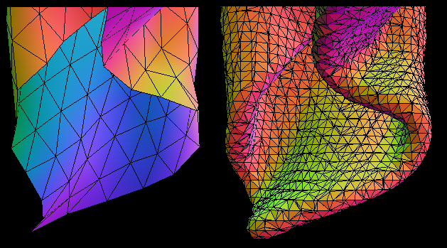
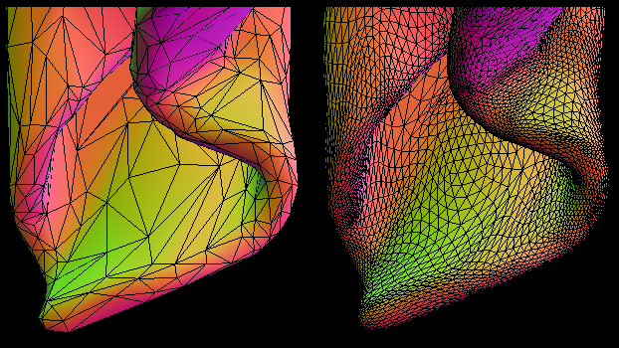
Quilting

Slide 24
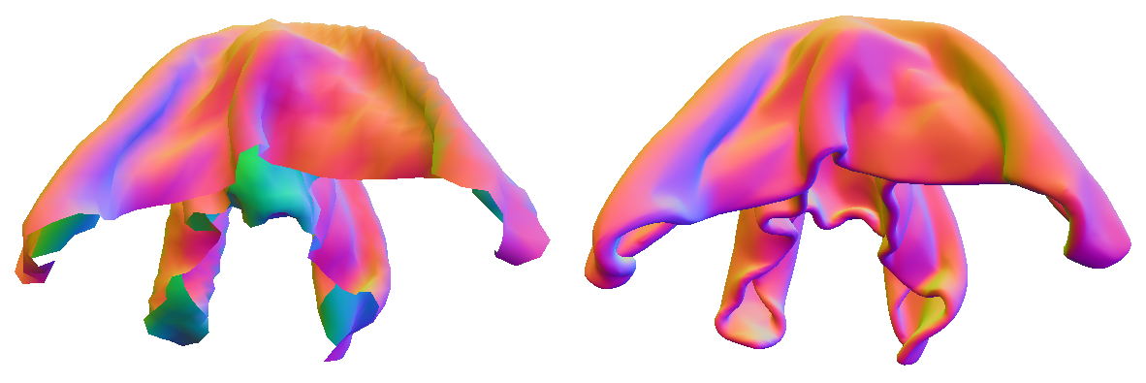
Quilting & Subdivision

Slide 25
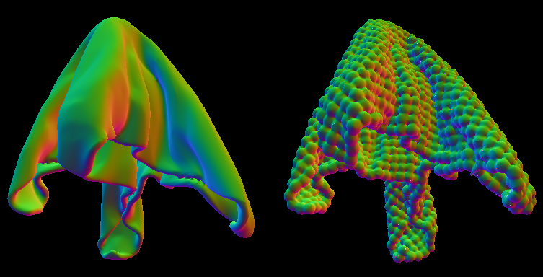
Variable Thickness Quilts

Slide 26
Videos…

Slide 27
Simple Hang

Slide 28
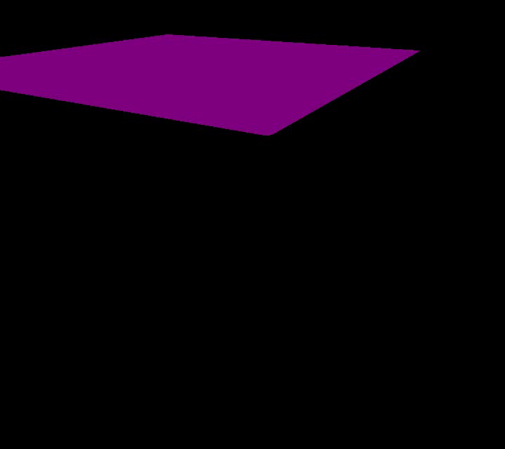

Slide 29
Cloth-Object Collision

Slide 30
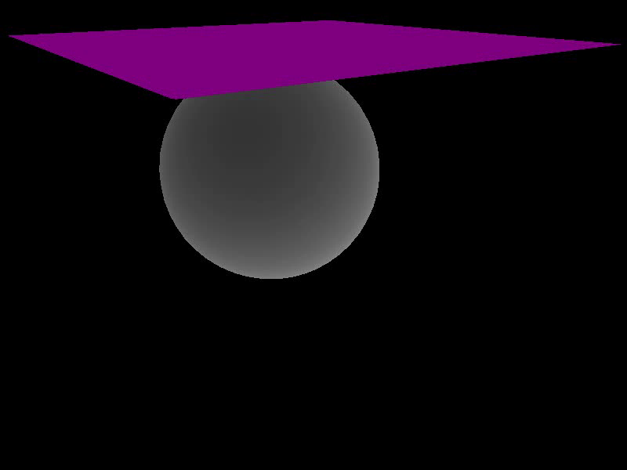

Slide 31
Cloth-Cloth Collision
Single Hold

Slide 32


Slide 33
Cloth-Cloth Collision
Double Hold

Slide 34


Slide 35
Cape

Slide 36
